Slide 1


ENGLISH PREMIER LEAGUE 2023/2024 SEASON ANALYSIS
GROUP MEMBERS: OSAIBO JOAN-MARY
DEHINBO EBENEZER
COURSE TRACK: DATA ANALYTICS
DATE: 20TH AUGUST, 2025.

Slide 2


INTRODUCTION
The Premier League dataset contains records of matches played during the 2023/2024 football season which is 9 months( August to May). 20 football clubs of England compete in the league and the winner is determined by the club that accumulates the most points.
The dataset includes teams, goals scored, match dates, round numbers and provides team level insights as well as serves as a valuable resource for understanding team performances in the league.
OBJECTIVES
The Goal of this analysis is to determine the following:
Top 4 that qualified for Champions League.
Bottom 3 that got Relegated ( that is, got dropped from the league to a lower league).
Team that automatically qualified for Europa League
Team that automatically qualified for Conference League.
Team that won all Matches.

Slide 3
DATA OVERVIEW
This Dataset was CSV file gotten from kaggle.com. It contains about 381 rows with 8 columns.
Key Variables/ Fields: Names, match dates, home team names, away team names, home goals, away goals.
Data Cleaning: The dataset required minimal cleaning as it was not so dirty, just the date column which was not in the right format and that was converted to the date data type.

Slide 4
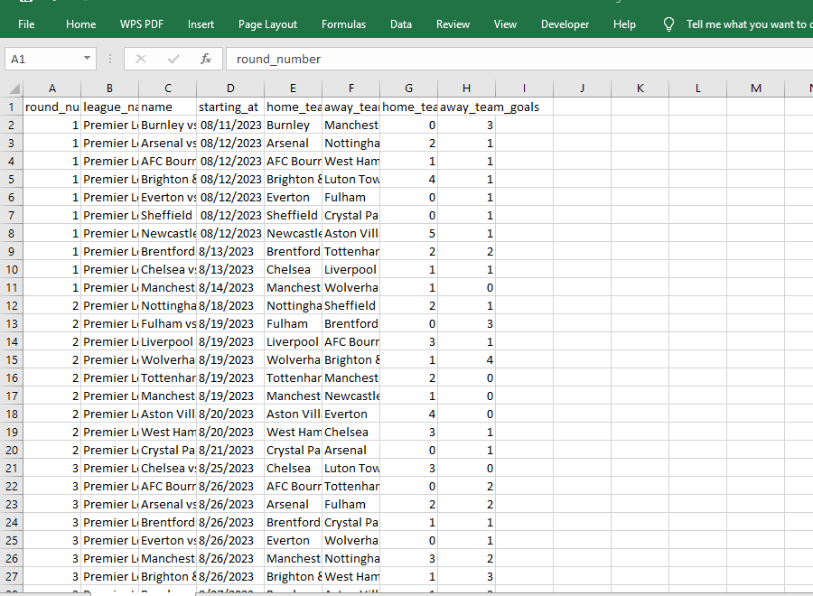
DIRTY DATA

Slide 5
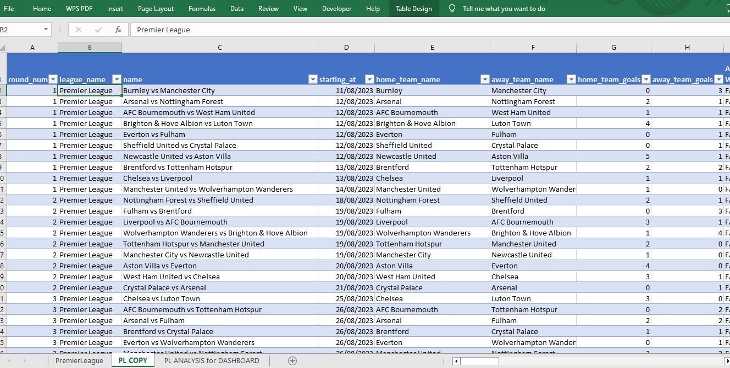
CLEAN DATA

Slide 6

TOOLS USED
Microsoft Excel: used this tool because a more detailed analysis was needed and the size of the dataset was okay for Excel.
Power BI: It was a better tool for visualizing the dataset.
METHODOLOGY
/
TOOLS USED
STEPS TAKEN IN ANALYSIS
Imported Data into Excel
Cleaned The Dataset: converted the date column to the date data type and removed blank rows.
Data Analysis: used the COUNT & IF functions to get needed columns for analysis and visualization.
Imported into Power BI: performed DAX functions to get additional information.
Visualization using Power BI

Slide 7
DATA ANALYSIS & VISUALIZATIONS

Slide 8
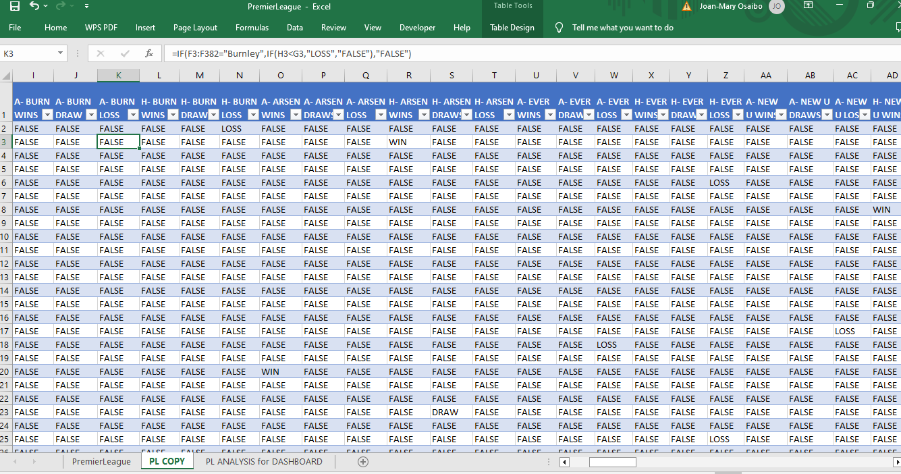
ANALYSIS

Slide 9
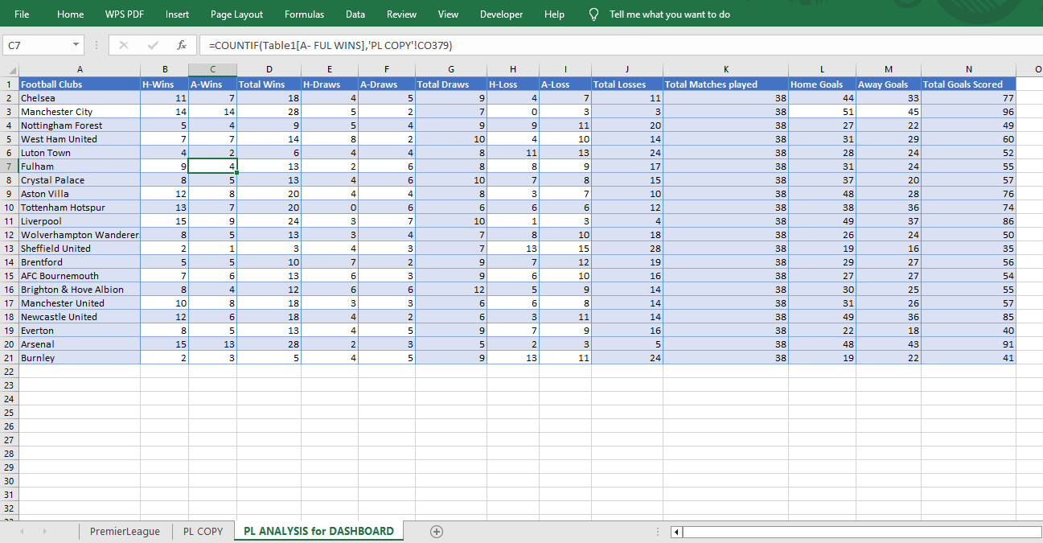
ANALYSIS

Slide 10
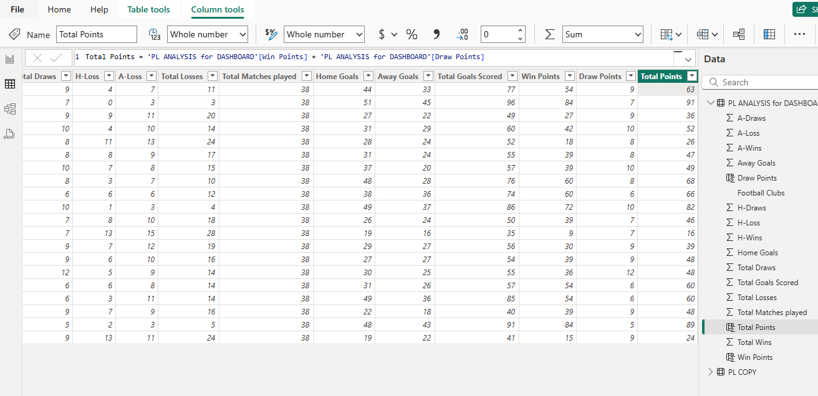
DAX FUNCTION TO GET TOTAL POINTS IN POWER BI

Slide 11
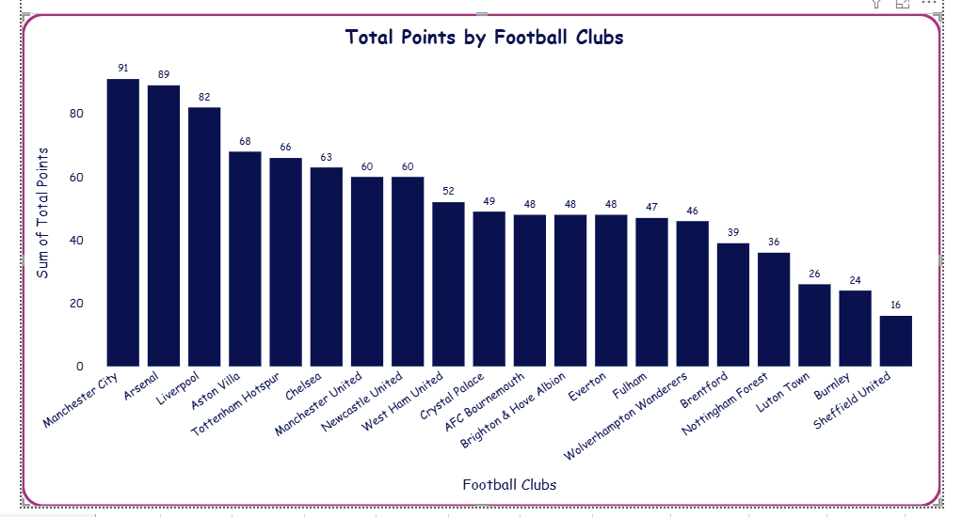
VISUALIZATIONS

Slide 12
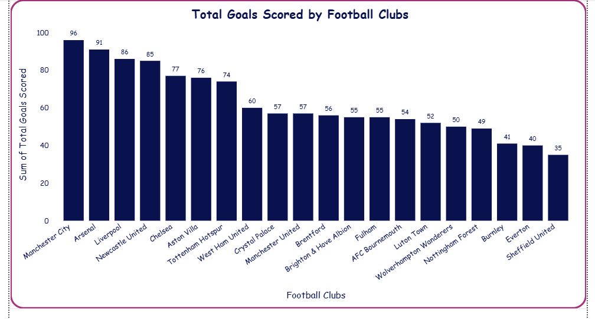
VISUALIZATIONS

Slide 13
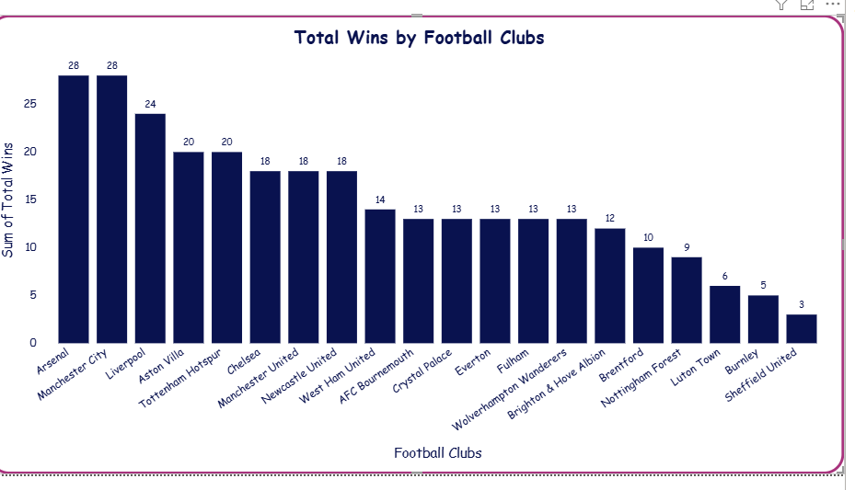
VISUALIZATIONS

Slide 14
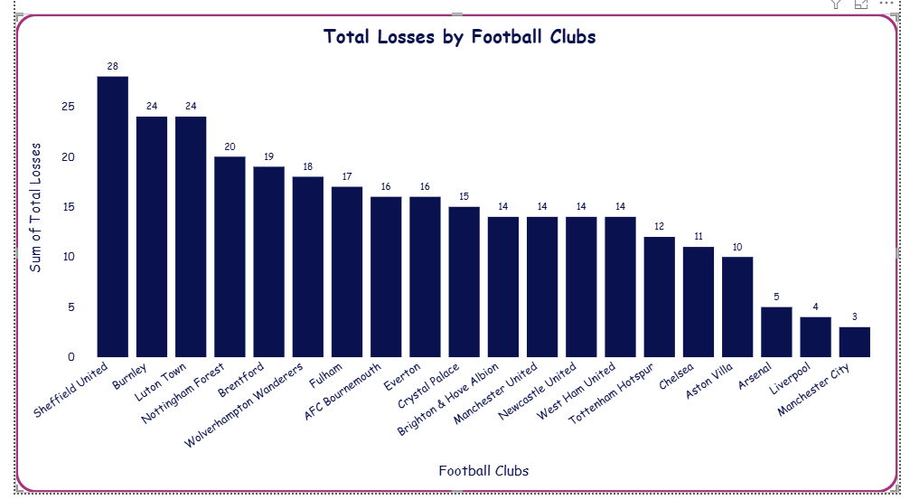
DATA ANALYSIS & VISUALIZATIONS

Slide 15
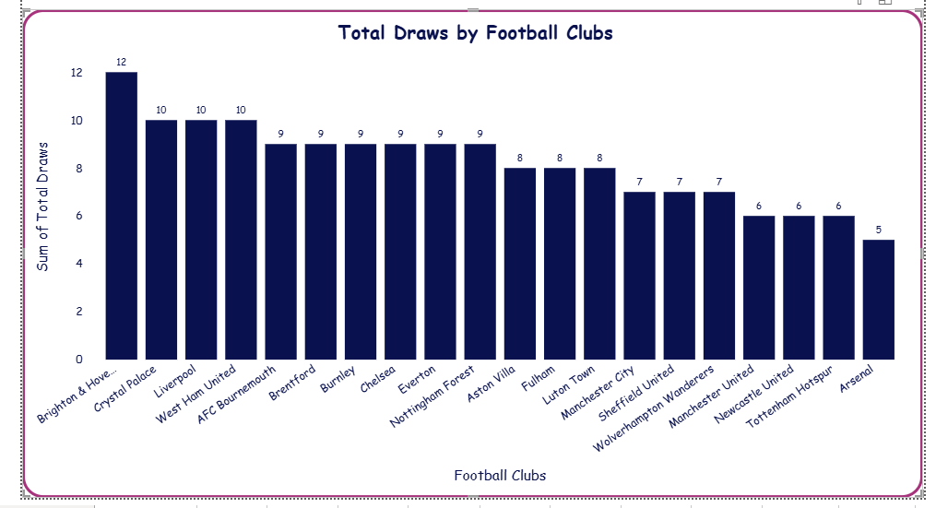
VISUALIZATIONS

Slide 16
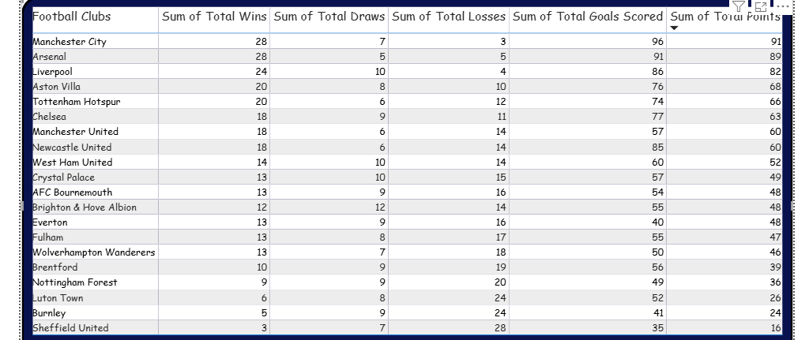
VISUALIZATIONS

Slide 17
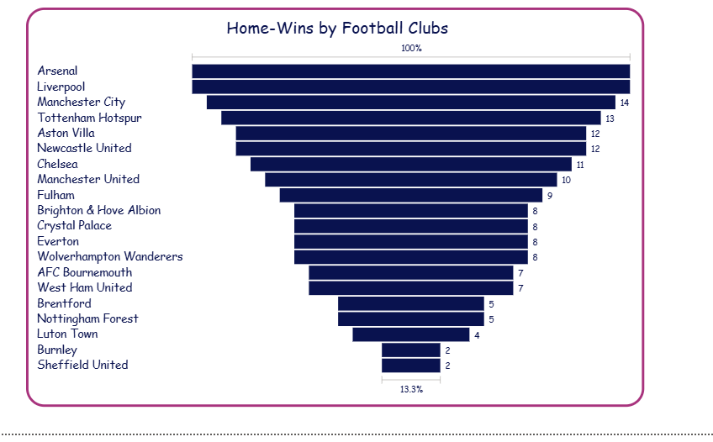
DATA ANALYSIS & VISUALIZATIONS

Slide 18
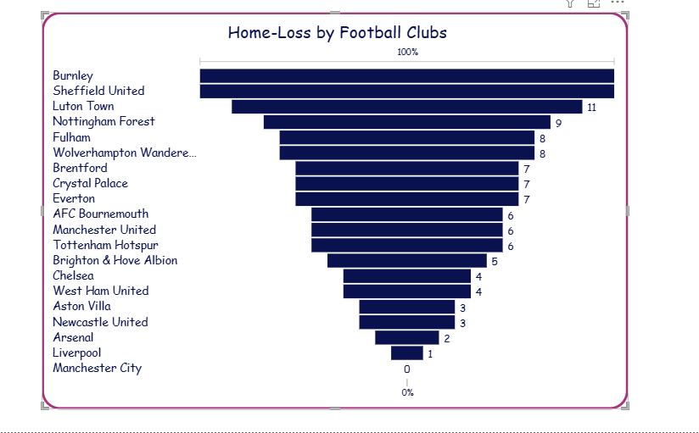
VISUALIZATIONS

Slide 19
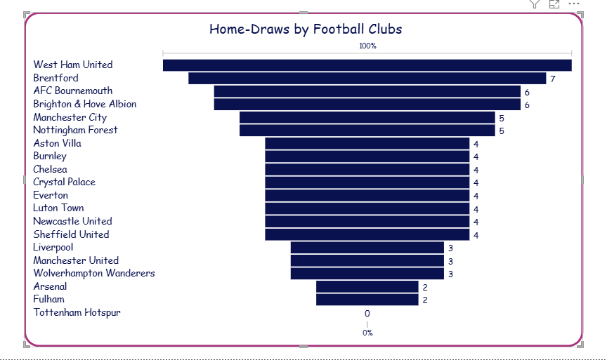
DATA ANALYSIS & VISUALIZATIONS

Slide 20
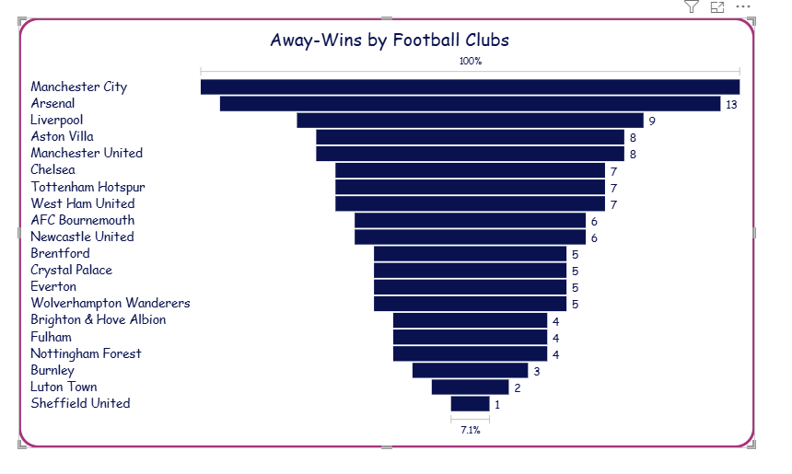
VISUALIZATIONS

Slide 21
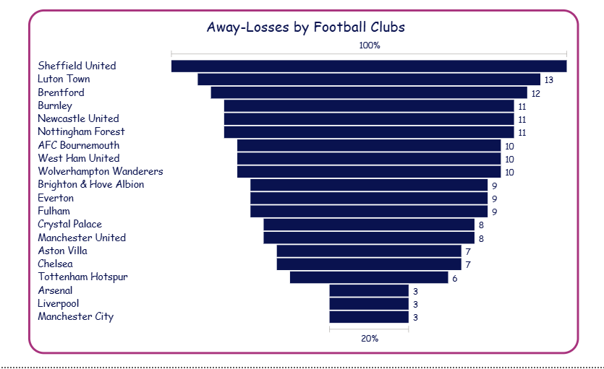
VISUALIZATIONS

Slide 22
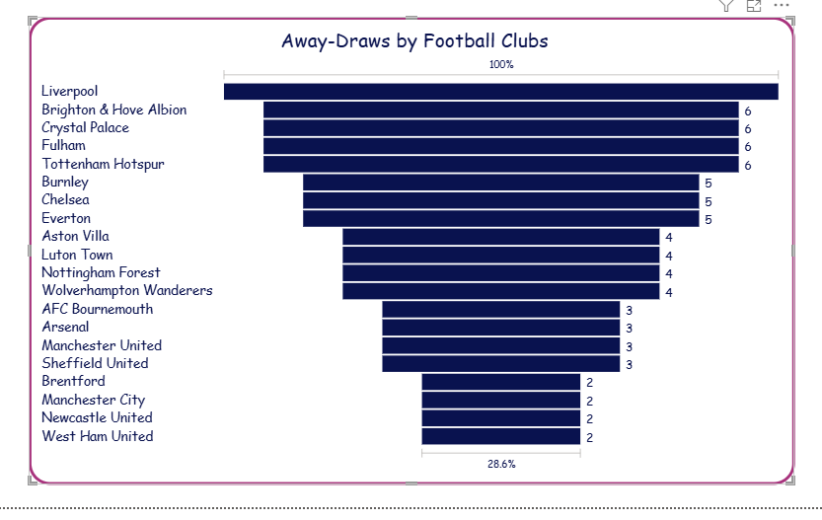
VISUALIZATIONS

Slide 23
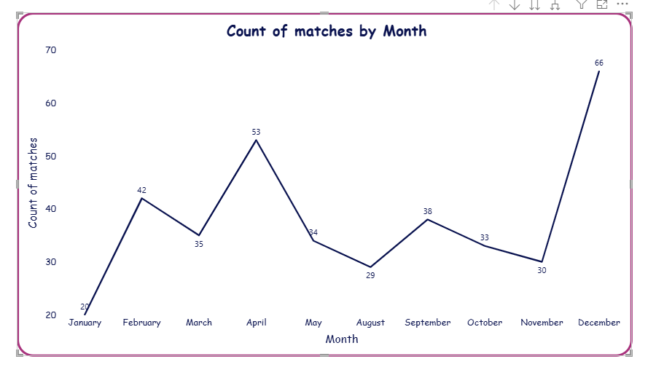
VISUALIZATIONS

Slide 24
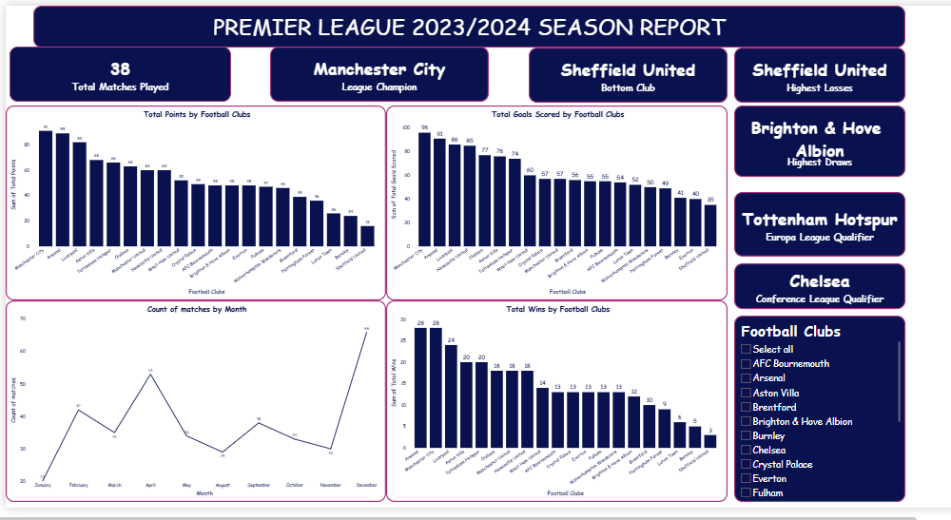
DASHBOARD

Slide 25
Manchester City won the league as a result of having the highest points. They also had the highest goals and highest Wins and the least losses.
The Top 4 teams: Man City, Arsenal, Liverpool & Aston Villa that had the highest points qualified for Champions league.
The 5th position which was Tottenham Hotspur qualified for Europa league.
The 6th position which was Chelsea Qualified for Conference league.
No team won all 38 matches.
The 3 bottom teams: : Luton Town, Burnley & Sheffield United got Relegated.
KEY FINDINGS/ INSIGHTS

Slide 26
Highest Goals scored in a match was 8 by Newcastle United at an away match.
Manchester City never lost a home match.
Sheffield United had the most losses.
Manchester City & Arsenal had the most wins.
Brighton & Hove Albion had the most draws.
Most teams performed better in home matches than away matches.
December 2023 had the most matches played while January 2024 had the least matches.
MORE INSIGHTS

Slide 27

RECOMMENDATIONS
Based on this analysis, Arsenal may likely be head-to-head for the cup next season and may even win it if they do better.
The next 3 bottom teams: Wolverhampton Wanderers, Brentford & Nottingham Forest, before the bottom 3 may likely get relegated next season if they don’t improve their performance.

Slide 28

CONCLUSION
This analysis revealed patterns in wins, draws and losses across teams. By examining goals scored, home and away performances and match outcomes, we discovered a clearer view of team strengths and consistency. This highlights how simple match data can provide powerful insights into the dynamics of the league.

Slide 29
www.kaggle.com www.google.com
REFERENCES
&
ACKNOWLEDGEMENT
Appreciation to JDPC and InternSify for this wonderful opportunity.
Special Thanks to our Tutor, Miss Dishaa Agarwal for always answering our questions and her wonderful way of teaching. We are grateful.

Slide 30
THANK YOU !!
QUESTIONS??

